Slide 1
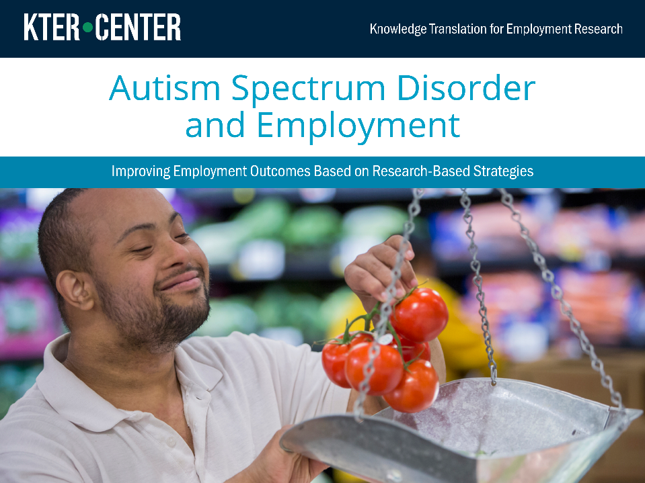

Slide 2


The contents of this training were developed under grant number 90DP0077 from the National Institute on Disability, Independent Living, and Rehabilitation Research (NIDILRR). NIDILRR is a Center within the Administration for Community Living (ACL), Department of Health and Human Services (HHS). The contents do not necessarily represent the policy of NIDILRR, ACL, HHS, and you should not assume endorsement by the Federal Government.
Copyright © 2018 by American Institutes for Research

Slide 3

Learning Objectives
At the end of this presentation, you will be able to:
Identify the variability of how autism spectrum disorder (ASD) is expressed.
Describe the variation of ASD and how that affects obtaining and maintaining employment.
Identify research-based recommendations for vocational rehabilitation (VR) counselors serving adults with autism.
Notes:
Because autism is a complex disorder, this training module will first review several "models" of autism, with an emphasis on the things that most impact employment. Following that, we will discuss a few other aspects of autism that are significant to providing accommodation and services to adults with autism.
Note: this is not about diagnosing ASD; just helping vocational rehabilitation or VR supervisors train counselors to help people with ASD.

Slide 4
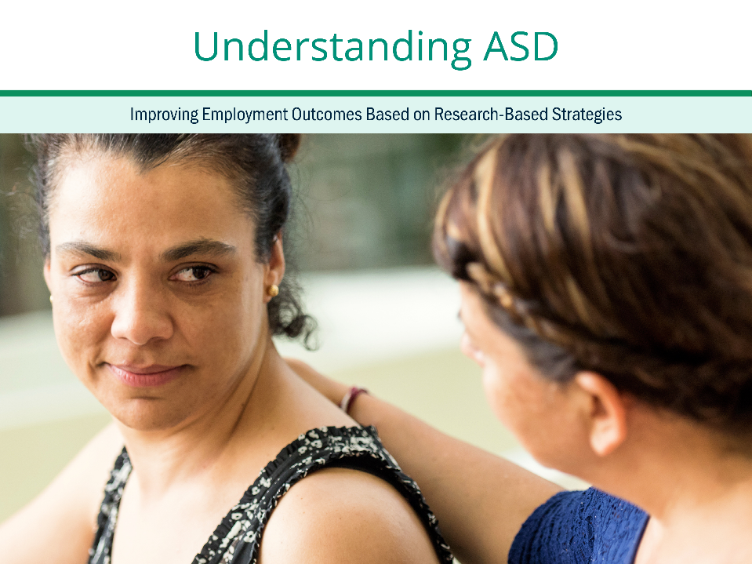
Appreciating Variation to Promote Employment Outcomes

Slide 5
Who Has Autism Spectrum Disorder?
In 2012, an estimated 1.5 percent of 8-year-old children were identified with ASD.¹
More children are being diagnosed with ASD than in the past.²
ASD is reported across all races and ethnicities.
ASD is 4.5 times more common in boys than girls.³
Criteria for ASD have changed:
  Older adults with ASD are more likely to have severe or profound intellectual disability.
Notes:
Changes in diagnostic definitions and public awareness over the past few decades have contributed to dramatic growth in the number of children identified as having an autism spectrum disorder (ASD). Approximately 1 percent of 8 year old children are identified as having ASD. About half a million youth on the autism spectrum will age into adulthood over the next decade. Half of middle-aged adults, or those between 45 and 64 with ASD had severe or profound intellectual disability, compared to less than a fifth of young adults or those between 18 to 24 with ASD.
ASD is reported to occur in all racial, ethnic, and socioeconomic groups. ASD is about 4.5 times more common among boys than among girls.

Slide 6
Hallmarks of ASD
Persistent social and communication challenges
  Conversations
  Nonverbal communication
  Developing, maintaining, and understanding relationships
Restricted, repetitive patterns of behavior, interests, or activities
  Repetitive movements, use of objects, or speech
  Strong focus on routines, patterns, same behaviors, activities,
  or things
  Strong focus on specific interests
  Sensitive or insensitive to environment
Source: American Psychiatric Association. (2013). Diagnostic and statistical manual of mental disorders (5th ed.). Washington, DC: Author.
Notes:
There are key signs to autism. The first is persistent social and communication challenges in multiple contexts. For example, individuals may not be able to start or acknowledge a conversation in a standard manner or may not be able to hold a conversation, or avoid sharing of interests or emotions. Individuals with ASD may also have challenges following normative non-verbal communication, such as avoiding eye contact and not understanding or using gestures. Individuals with ASD may experience challenges with developing, maintaining, and understanding relationships. For example, an individual may have difficulty making changes, lack of interest in peers, and changing behavior in different contexts.
The second key sign is restricted or repetitive patterns of behavior or interests. For example, an individual may line up objects or repeat a phrase. An individual may also have an strong preference and adherence to routines and thus may show distress at small changes another example is eating the same food or wearing the same clothes every day. Individuals with ASD may also focus on a specific interest, for example focusing excessively on baseball.
The third key sign is that individuals with ASD may also be very sensitive or insensitive—for example, they may be indifferent to pain or temperature, or another individual may be extremely sensitive to smells.
Autism is identified at an early age and as adults impairs current activities such as social skills, obtaining and maintaining a job. Autism is also not explained by another disability such as an intellectual disability, however, individuals frequently have other disabilities, such as an intellectual disability, or catatonia, the abnormal movements or behavior when someone is upset.

Slide 7
Key Issues for Vocational Rehabilitation Settings
Executive functioning includes skills such as planning, sequencing activities, attending, and poor self-regulation.
Understanding others, or Theory of Mind, refers to one’s ability
to perceive how others think and feel, and how that relates
to oneself.
  Difficulty explaining one’s behaviors
  Difficulty understanding emotions or perspectives of others
  Difficulty predicting the behavior or intentions of others
  Lack of understanding that behavior impacts how others think or feel
  Problems differentiating fiction from fact
Notes:
In addition, for vocational rehabilitation purposes, it can be helpful to consider two issues that frequently emerge for individuals with ASD. Some individuals with ASD may have poor executive functioning, or the ability to plan activities, and related to this, may be able to see the details, but not the larger picture. Others have difficulty maintaining their attention, or organizing their thoughts and actions. Executive functioning difficulties can also be associated with poor impulse control.
Theory of mind refers to one’s ability to perceive how others think and feel, and how that relates to oneself. This challenge often leads others to believe that the individual with ASD does not have empathy or understand the person, causing social problems. It is also the case that often individuals with ASD may not be aware that they lack this ability. Thus, when training VR counselors about individuals with ASD and when discussing coaching needs for individuals with ASD, it may be helpful to take into consideration how individuals with ASD perceive others.

Slide 8

ASD is a Spectrum Disorder
Source: American Psychiatric Association. (2013). Diagnostic and statistical manual of mental disorders (5th ed.). Washington, DC: Author.
Notes:
While diagnosing autism is complex and important, at the end of the day, for VR counselors, it might be better to think about the level of impact autism has on an individual.

Slide 9
Which Level Will Need VR Services the Most?
Answer: All levels, but the difficulty of each level may surprise you.
Level 1 (needs support)
  Academically strong
  Educated on grade level with accommodations
  More likely to fail in college
Level 2 (substantial support)
  One to two grade levels below and receives modifications
  May receive more social skills interventions and vocational experience
  Often overlooked for college or specialized training
  Level 3 (very substantial supports—will need lifelong supports)
  Substantial educational supports and modifications
  Lifelong supports necessary
  Easiest to place
Notes:
Surprisingly, individuals with a level 1 can be the most challenging. In school, they were academically strong. They were most likely educated on grade level and received only accommodations. They typically took full course loads with little room for social skill intervention or vocational experience. After these individuals graduate high school, they are more likely to fail in college, other post secondary options and be underemployed.
Individuals with a level 2 may be underestimated in terms of their educational abilities. If still in school, they are typically enrolled at one or two grade levels below other students the same age, and receive modifications to their coursework. Despite having more flexibility in their course schedules, given low expectations others perceive, they are most at risk for being overlooked for enrollment in college or specialized training programs.
Although individuals with a level 3 needs will need life long supports, they can be the easiest to place. Since they were most likely to be educated in a self contained setting, they had the greater opportunity to receive more intense intervention. Many of these of individuals will love simple, repetitive jobs.

Slide 10

Autism in the Workplace
Paid, community-based employment is uncommon for adults with ASD, with only 14 percent achieving employment.
  More than half (54 percent) participated in an unpaid activity.
  One-fourth (27 percent) had no work or day activities.
Ninety percent of employment loss for individuals with disabilities related to poor social communication skills.
Notes:
Based on the data from the National Core Indicators project and the American Community Survey, research indicated that deficits in social communication skills have been responsible for almost 90 percent of employment loss for individual with disabilities (3).
Reports showed that workers with ASD have exhibited social communication difficulties with supervisors and co-workers, and this barrier has served as the primary hindrance to job performance. Realizing the importance of social communication skills to help adults with ASD acquire positive employment outcomes, there is a need for evidence-based strategies to improve employment outcomes for this population.

Slide 11
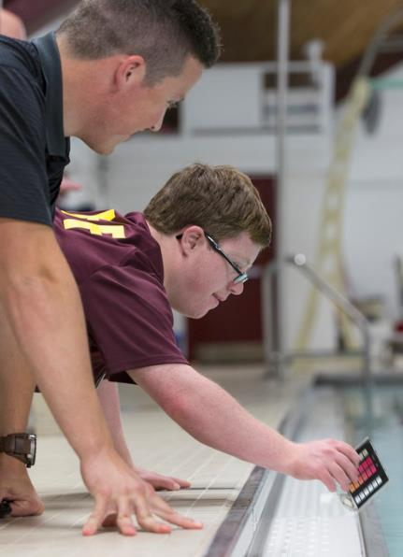
Focus on Individuals’ Strengths
What do you think of someone who:
Has the ability to see fine details
Has an exceptional memory
Is dependable and reliable
Is very trainable and craves instruction
Once he or she is trained, will not deviate from instruction
Likes and is good at repetitive work
Is straightforward and extremely honest
Notes:
When talking with VR counselors about individuals with ASD, it may be helpful to focus on strengths of individuals with ASD, rather than just their challenges. This is also more person-centered approach and may help to identify types of jobs that would work well for someone with ASD.

Slide 12
Understand Struggles
Do these behaviors describe your clients with ASD?
Has sensory sensitivities
Struggles to communicate effectively
Struggles to see the “big picture”
Struggles to problem-solve when given a situation they have not incurred before
Can be very “black and white”—has a hard time “thinking outside
of the box”
Ability to process information is impaired and slow
Usually are not motivated by social pressure or social norms
Changes are difficult and anxiety provoking
Notes:
It is also important to consider potential struggles. Again, not all of these apply, but it may be worth a VR counselor to check in and assess if their client struggles with any of these.

Slide 13
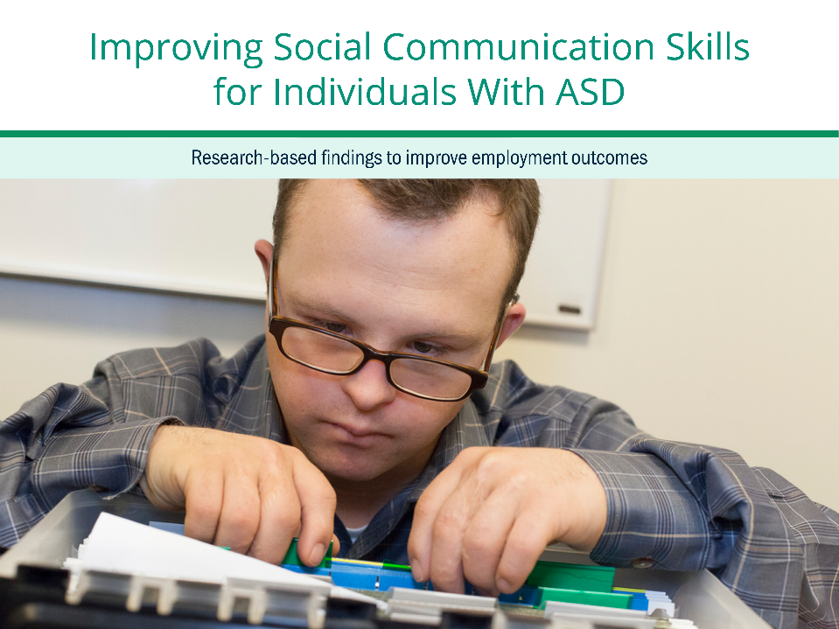
Research-based Findings to Improve Employment Outcomes
Notes:
Now that we have discussed what it means to have autism spectrum disorder, we will now move into improving social communication skills for individuals with ASD.

Slide 14

Methods for Identifying Research Based Practices
Research question: How can VR counselors better support the social and communication skills of adults with ASD?
Literature and products from 1998 through February 2017 focusing on autism, job-related social skills, workplace communication, and disclosure.
  Of the 210 products reviewed, 29 research studies and products were included in the review.
Notes:
First, our goal is to present research-based information to identify how Vocational Rehabilitation, or VR, counselors can better support the social and communication skills of adults with ASD as it relates to employment.
To do that, we examined literature and products such as research-based trainings to identify to improve employment outcomes. We reviewed articles primarily published in the US, but also included a few other countries focusing on communication and social skills for individuals with audism. Ultimately, we examine 210 articles and products and of that 29 were included in our literature review.

Slide 15
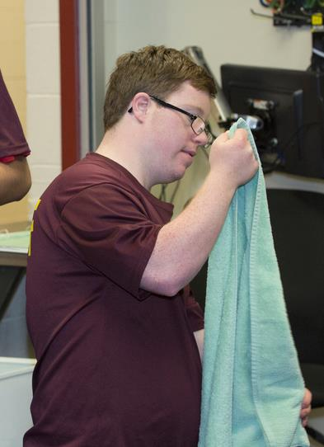
Research Findings:
Social and Communication Skills for Employment
Results addressed four areas relevant to individuals with ASD:
Interviewing skills
On-the-job social skills
Self-advocacy
Compensatory strategies
Notes:
After looking at the literature and other products, four themes emerged: Interviewing skills to obtain a job, social skills used on the job, self advocacy and making decisions for yourself, and compensatory strategies to remind oneself about activities.

Slide 16

Strategy 1: Train on Interviewing Skills
Definition: Part of social skills—and a key to obtaining a job
What the research says/best practice:^{4,5,6,7}
  Practice makes perfect
  Modeling interview skills
How does it help?
  Improves verbal content
  Improves small talk, attitude, and opening and closing interviews
Notes:
Not surprisingly, practicing, using role-play and mock-interviews with explicit instruction social skills such as small talk, attitude, and lessons on how to open and close improved performance, at least for mock interviews. One high-tech study using virtual reality job interview training improved interviewee performance during live standardized role plays.
Modeling interview skills was shown in two studies to enhance ratings by interviewers and in one to increase rates of obtaining internships.

Slide 17

Strategy 2: Support On-the-Job Social Skills
Definition: On-the-job social
skills training targets those skills necessary for employment:
Interpreting social and contextual cues
Understanding the perspectives and emotions
of others
Maintaining equitable and reciprocal conversations
Understanding nonverbal cues
Notes:
When we talk about on-the-job social skills, they are often behaviors that we don’t think about. Saying hello to and holding conversations with colleagues for example, or understanding when someone is having a bad day and showing empathy. Alternatively, if someone keeps looking at their watch, knowing that you need to keep the conversation short and move on.

Slide 18
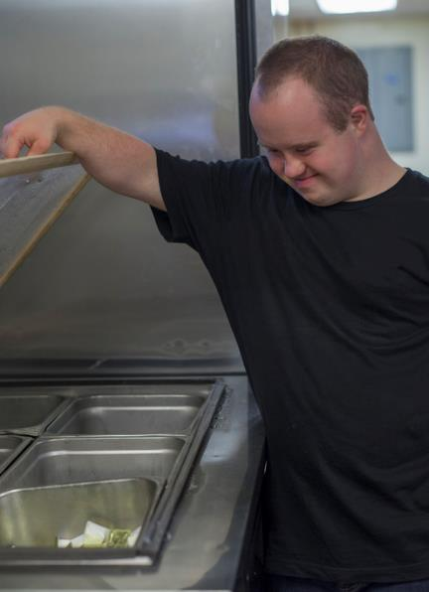
Strategy 2: Support On-the-Job Social Skills
Possible challenges include:
Lack of verbalizations
Deficits in verbal reciprocity
Repetitive speech
Inappropriate body language
New Picture
Notes:
For individuals with autism, on-the-job social skills can be challenging. For example, some people with ASD are non-verbal or may not always talk. They may have difficulties in simple conversations. They may repeat phrases or words also called echolalia. Finally, some people with ASD may have inappropriate body language, such as turning away, standing too close or too far away.
Also, as an aside, these are challenges for neurotypical adults when interacting with individuals with ASD. Some of these “challenges” such as repeating words or phrases are actually supportive of learning language.

Slide 19
Strategy 2: Support On-the-Job
Social Skills Through Group Meetings
What the research says: Group interactions support the development of social skills and problem-solving skills:^{4,8,9}
  Similar to counseling
  Four to 14 individuals with ASD
  One to two meetings a week for 8 to 12 weeks
  Each meeting would focus on specific topics, such as conversational skills or working with difficult people
Best Practice: VR agencies should develop a short-term group program to support the development of social skills.
Notes:
What supports on-the-job social skills? The first key activity that supports on-the-job social skills is group meetings that are similar to counseling support groups. In these types of interventions, the foci and the outcomes typically related to social and vocational skills, problem-solving, interpersonal relationships, coping strategies, and communication skills. In these types of activities, group members learn by practicing, learning from each other by sharing personal experiences and listening to others, by giving advice. In one study by Brock, almost two thirds of participants had a paid or unpaid internship after the program. One of the case studies will provide more guidance regarding this style of developing social skills.

Slide 20
Strategy 2: Support On-the-Job Social Skills
Through Job Coaching and Supported Employment
What the research says: Job coaching involved a vocational specialist who provided on-the-job coaching and cueing to support new workers’ improvement of social and communication skills.
  Faded coaching and covert audio coaching enhanced workers’ engagement.¹⁰
  Job coaching is highlighted in a directory of effective VR programs that offered services to promote employment for adults with ASD.¹³
  In one supported employment study, supported employment enhanced social skills, confidence, communication, and behavior by 40 percent to 50 percent.¹¹
  Another study examined supported employment and found it resulted in 82 percent of participants obtaining employment.¹²
Best Practice: Refer clients to job coaches and involve them in supported employment endeavors.
Notes:
For example, faded coaching, where job coaching is slowly faded out, and using a covert audio device—in other words an ear piece for the client and a phone or walkie talkie for the coach allowed the coach to provide coaching without being too close. It supported workers engaging in tasks on time and increased social interactions.
Other studies focusing on supported employment, which includes support obtaining and maintaining a job. These generally assisted participants obtaining a job and improving social and communication skills.

Slide 21
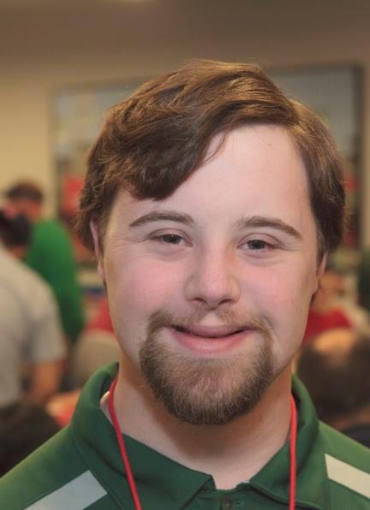
Strategy 3: Improve Self-Advocacy: Definition
Self-advocacy is typically understood to reflect one’s ability to conceptualize, understand, speak for, and generally exercise control over their needs and interests in life activities.
Specifically: Negotiating with one's supervisor to arrange for your own reasonable accommodations in the workplace.
Notes:
In this context, self-advocacy refers to the ability to advocate for reasonable employment accommodations on behalf of oneself. Self-advocacy training is often part of a larger program for teaching social skills communication.

Slide 22
Strategy 3: Improve Self-Advocacy
Through Job Coaching
What the research says:
  Individualized job coaching supports increased:^{4,10,14}
    Self-advocacy
    Social interaction
    Task engagement
    Self-awareness
  Technology also has assisted with increased self-advocacy skills:¹⁰
    Audio instruction through an earpiece improved social and communication skills.
Best Practice: Refer clients to job coaches who can support on-the-job self-advocacy.
Notes:
In skill 2, we noted that job coaching supported on-the-job social skills. Job coaching is also helpful in training individuals to advocate for themselves. Effective practices of job coaches included role-playing, modeling, corrective feedback, direct instruction, and instructing on learning strategies. The two intervention studies found associations between job coaching and increased awareness of self-advocacy once the job coach had faded away or individualized sessions had ended.
In one of the studies, job coaches provided guidance through the use of technology where the job coach provided instruction through an ear piece. Again, this resulted in improved social and communication skills.
In fact, a systematic review on the effects of adult employment assistance services found that tailored job coaching was one of the most important supports for success in employment for adults with autism.

Slide 23
Strategy 3: Improve Self-Advocacy
Through Group Training
What the research says:
  Group training sessions associated with some increased
  self-advocacy skills:^{4,15}
    Self-advocacy and self-determination was increased in the short term
    Improving written and oral communication requests for time or asking for extra support
Best Practice: Consider group training sessions on self-advocacy and self-determination.
Notes:
In one study, group training sessions focused on planning, creative problem-solving and identifying quality services and led to increased self-determination, but only in the short-term.

Slide 24

Strategy 4: Use Compensatory Strategies
Definition: Anything that helps someone remember to perform an activity or social interaction without guidance from another:
Training
Memory aids
Checklists
Technology supports
Notes:
Compensatory strategies are anything that supports learning or completion of a particular task without prompting or assistance by others.¹⁷ Examples of strategies include training, reminders, checklists, and technological assistance. These memory aids are not just for perform activities and planning, but can also be for improving communication.

Slide 25

Strategy 4: Use Compensatory Strategies
What the research says
  Checklists or other memory aids on paper, tablets, or other technology improves planning and completion of tasks.^{12,16,17}
  Technological devices such
  as walkie-talkies, laptops,
  and tablets support improving social communication skills.^{12,16,17}
Best Practice: VR counselors should work with clients to identify appropriate compensatory practices.
Notes:
Not surprisingly, standard memory aids, such as checklists, using an IPad, or other technology improves ones ability to complete tasks. Thus, for example, in one study, an employee was audio support and picture schedules to support the employee to learn to match identical product logos, in this case two cans of Pepsi so that the employee could assist in refilling the soda vending machine. He then learned to match the logos to a specific product as a way of requesting the correct type of soda.
Technology has definitely supported employees in reminding them to communicate. For example, In one study, an iPod Touch was successfully used to support employment independence through the use of visual cues facilitating social interaction. Similarly, in another study, IPads were used to improve social communication skills and support employment independence in a separate study. With the help of iPad video prompts, one of the participants learned how to structure her day and how to interact appropriately with co-workers.

Slide 26
Citations
Christensen, D. L., Baio, J., Braun, K. V., Bilder, D., Charles, J., Constantino, J. N.,…Yeargin-Allsopp, M. (2016). Prevalence and characteristics of autism spectrum disorder among children aged 8 years—Autism and Developmental Disabilities Monitoring Network, 11 sites, United States, 2012. MMWR Surveillance Summaries, 65(No. SS-3), 1–23. doi: http://dx.doi.org/10.15585/mmwr.ss6503a1
Roux, A. M., Rast, J. E., Anderson, K. A., & Shattuck, P. T. (2017). National autism indicators report: Developmental disability services and outcomes in adulthood. Philadelphia, PA: Life Course Outcomes Program, A.J. Drexel Autism Institute, Drexel University.
Centers for Disease Control and Prevention, Division of Birth Defects, National Center on Birth Defects and Developmental Disabilities. (2017). Autism spectrum disorder (ASD) data and statistics. Retrieved from https://www.cdc.gov/ncbddd/autism/data.html
Brock, M., Hughes, D., & Searcy, K. L. (n.d.). Workplace communication: Supporting young adults with autism to successful jobs [PowerPoint]. Retrieved from http://www.asha.org/Events/convention/handouts/2011/Brock-Hughes-Searcy/
Morgan, L., Leatzow, A., Clark, S., & Siller, M. (2014). Interview skills for adults with autism spectrum disorder: A pilot randomized controlled trial. Journal of Autism and Developmental Disorders, 44(9), 2290–2300.
Smith, M. J., Fleming, M. F., Wright, M. A., Losh, M., Humm, L. B., Olsen, D., & Bell, M. D. (2015). Brief report: Vocational outcomes for young adults with autism spectrum disorders at six months after virtual reality job interview training. Journal of Autism and Developmental Disorders, 45(10), 3364–3369.
Strickland, D., Coles, C., & Southern, L. (2013). JobTIPS: A transition to employment program for individuals with autism spectrum disorders. Journal of Autism and Developmental Disorders, 43(10), 2472–2483.
Bonete, S., Calero, M. D., & Fernandez-Parra, A. (2015). Group training in interpersonal problem-solving skills for workplace adaptation of adolescents and adults with Asperger syndrome: A preliminary study. Autism: The International Journal of Research and Practice, 19(4), 409–420.

Slide 27
Citations
Hillier, A. J., Fish, T., Siegel, J. H., & Beversdorf, D. Q. (2011). Social and vocational skills training reduces self-reported anxiety and depression among young adults on the autism spectrum. Journal of Developmental and Physical Disabilities, 23, 267–276.
Gilson, C. B., & Carter, E. W. (2016). Promoting social interactions and job independence for college students with autism or intellectual disability: A pilot study. Journal of Autism and Developmental Disorders, 46(11), 3583–3596.
Lynas L. (2014). Project ABLE (Autism: Building Links to Employment): A specialist employment service for young people and adults with an autism spectrum condition. Journal of Vocational Rehabilitation, 41(1), 13–21.
Wehman, P., Lau, S., Molinelli, A., Brooke, V., Thompson, K., Moore, C., & West, M. (2012). Supported employment for young adults with autism spectrum disorder: Preliminary data. Research and Practice for Persons with Severe Disabilities, 37(3), 160–169.
Williams, A. (2013). Guide to effective employment programs. Austin, TX: SEDL. Retrieved from https://kter.org/resources/guide-effective-employment-programs-vr-service-models-individual-asd
Westbrook, J., Nye, C., Fong, C., Wan, J., Cortopassi, T., & Martin F. (2012). Adult employment assistance for persons with autism spectrum disorders: Effects on employment outcomes. Campbell Systematic Reviews, 5.
Hagner, D., Kurtz, A., Cloutier, H., Arakelian, C., Brucker, D. L. (2012). Outcomes of a family-centered transition process for students with autism spectrum disorders. Focus on Autism and Other Developmental Disabilities, 27(1), 42–50.
Foley, B. E., & Staples, A. H. (2003). Developing augmentative and alternative communication (AAC) and literacy interventions in a supported employment setting. Topics in Language Disorders, 23(4), 325–343.
Hill, D. A., Belcher, L., Brigman, H. E., Renner, S., & Stephens, B. (2013). The Apple iPad ™ as an innovative employment support for young adults with autism spectrum disorder and other developmental disabilities. Journal of Applied Rehabilitation Counseling, 44(1), 28–37.

