Slide 1
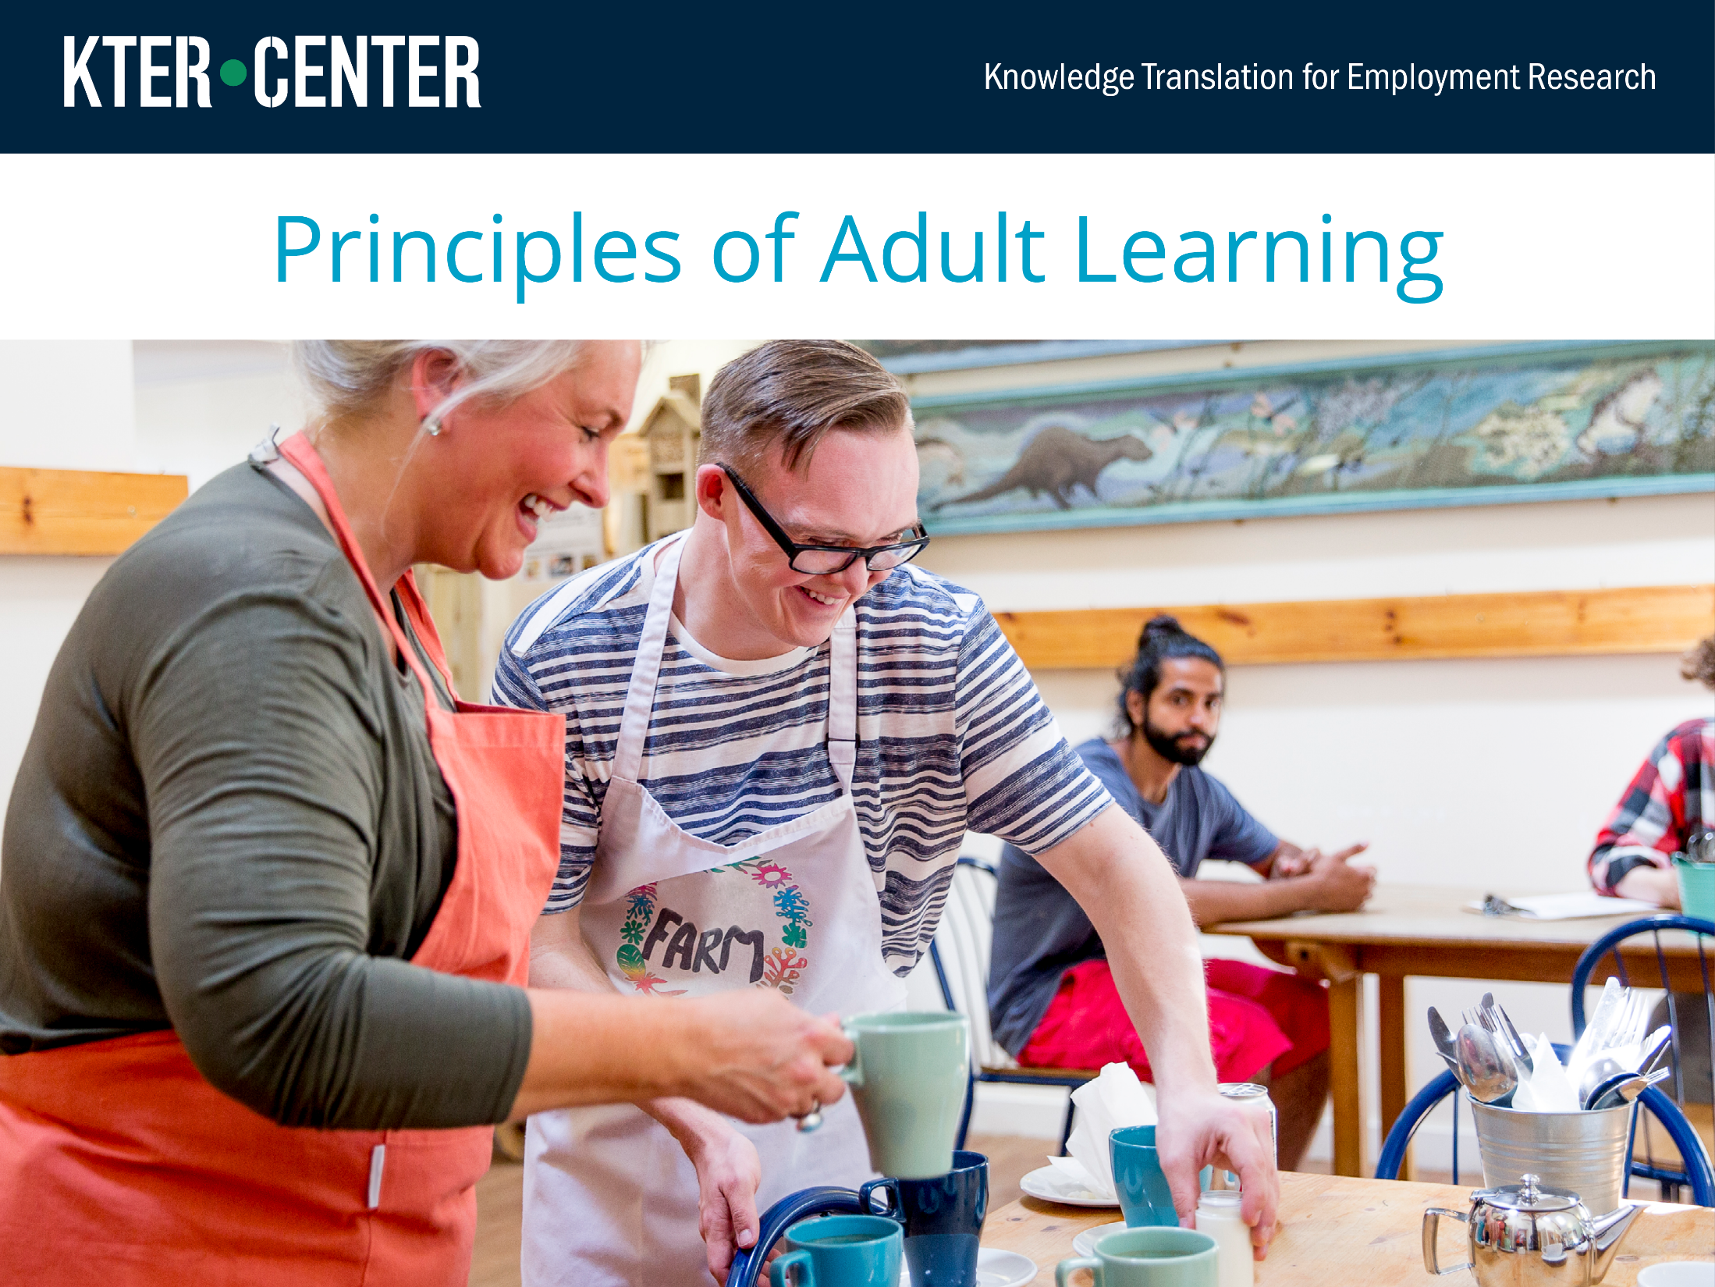
Notes:
In this module, we will be talking about how to plan and deliver information to adult learners in ways that are consistent with how adults learn new material and apply it to their situation.

Slide 2
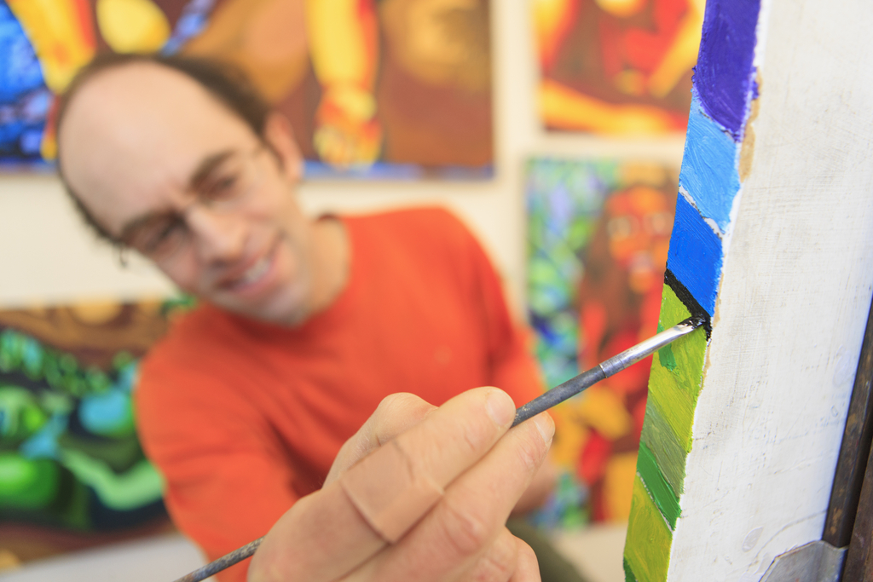

The contents of this training was developed under grant number 90DP0077 from the National Institute on Disability, Independent Living, and Rehabilitation Research (NIDILRR). NIDILRR is a Center within the Administration for Community Living (ACL), Department of Health and Human Services (HHS). The contents do not necessarily represent the policy of NIDILRR, ACL, HHS, and you should not assume endorsement by the Federal Government.
Copyright © 2018 by American Institutes for Research

Slide 3

Learning Objectives
Identify the principles of adult learning.
Propose ways to incorporate adult learning principles into training for vocational rehabilitation (VR) counselors.
Notes:
The goals of this module are to identify the main principles that define adult learning and propose ways to make these principles part of planning training for VR counselors.

Slide 4
Principles of Adult Learning
What are the characteristics of adult learners?
They are autonomous and self-directed.
They bring life experiences and knowledge and should be treated with respect.
They are goal oriented: They know what they want to do.
They are relevancy oriented: They need to see the reason for learning something new and how it applies to their situation or interests.
They are practical and want to learn things that directly help them in their jobs.
Sources: Knowles, M. (1984). The adult learner: A neglected species (3rd ed.). Houston, TX: Gulf Publishing. Lieb, S. (1991). Principles of adult learning.
Retrieved from http://honolulu.hawaii.edu/intranet/committees/FacDevCom/guidebk/teachtip/adults-2.htm
Notes:
We know that adults learn differently from children. These are some key principles to keep in mind when planning training for adults. And because you are all adult learners yourselves, we can see how they apply to this module:
Adults are autonomous and self-directed: They need to be free to make choices and be involved in the learning process. Adults can take responsibility for leading groups, sharing their knowledge, and helping the instructor make sure the training is as relevant as possible to their interests. In today’s training, we will ask you to apply these principles to your own situations.
Adults have their own life experiences and knowledge, which should be valued and respected as part of the training process. Good instruction will relate theories or skills back to the participants’ own knowledge. All of you come in with existing knowledge about VR training. Based on your experience, what are some things that are unique about that environment that might make teaching easier or more difficult?
Adults are goal oriented. They come to the classroom knowing what they want to achieve. A well-designed instructional program will clearly lay out the objectives of the program and help learners see how it is relevant to their goals. This training is part of a larger curriculum to give you the skills to train VR counselors on [program]. If it does not meet those needs or is too general, you will walk away frustrated.
Adults are relevancy oriented. Adult learners have a lot of competition for their time and energy. To be successful, an instructional program must have a clear connection to their own settings. We could teach the same material about training nurses or lawyers, but you would be frustrated.
Finally, adults are practical. They want to know things that help them in their jobs. Each of you comes into this training with your own concerns about how to do VR training, your own ideas about what will or will not work in your situation, and your own preferences for what works. You might be interested in theories in general, but you will get more out of the training if you come away with solutions that you can apply directly.
Underlying all these principles is respect: You bring knowledge as trainers, and the people you train bring knowledge of their roles as VR counselors and the needs and preferences of their own clients. Good training recognizes and respects what adults bring to the table and uses it to make the training as meaningful as possible.

Slide 5

Key Concepts in Adult Learning
Knowledge: Show learners that a gap exists and fill it.
Attitude: Show learners why they should care and want to make a change, incorporate new information, or take on a new practice.
Skills: Point by point, show how it can be done.
Practice: Give an opportunity for learners to try it out—a case study, a quiz, or a discussion.
Notes:
Knowledge, attitude, skills, and practice are common concepts that are evaluated when looking at effective learning. Each plays an important role in addressing the needs of adult learners.
The first is knowledge: Help learners identify a gap in what they know or do. In some cases, attitude is an important piece of the puzzle. If adult learners feel that barriers exist to incorporating new knowledge or processes in their settings, all the knowledge and skills that training provides might not be enough to help put it into practice. These relate back to adult learners’ autonomy and preexisting knowledge: Learners know their work environments and often have clear ideas about what could be better and what stands in the way. Successful training needs to incorporate the learners’ knowledge and concerns.
After identifying a problem and solution and determining that it can be addressed, it is important to teach concrete skills, not abstract concepts. Show how to complete an evaluation form or model a client interview.
The last component is practice: Give learners a chance to try out the new knowledge and skills for themselves. This builds ownership and confidence and, ideally, provides a chance for learners to apply the information in a way that is relatable to their own settings. This makes the new information more actionable and goal oriented.

Slide 6

Case Study: Determining Client Interests
Knowledge: Show learners that a gap exists and fill it.
Attitude: Show learners why they should care and want to make a change, incorporate new information, or take on a new practice.
Skills: Point by point, show how it can be done.
Practice: Give an opportunity for learners to try it out—a case study, a quiz, or a discussion.
Notes:
One key success factor identified in many VR programs for people with autism spectrum disorder is identifying skills or types of work that the client finds interesting or motivating. VR programs may vary in how they include this process during client intake and assessment. Let’s go through this together:
What are some ways that you would introduce best practices for determining client interests when training VR staff? Suppose you want to take a practice highlighted by another center, such as the Groden Network, which performs individual assessments of each client’s vocational interests and skills. The first part of knowledge transfer is describing what this intervention is and how it is used in another setting. You might describe how it fits into a client’s overall trajectory in that organization or share data that shows how this intervention helps make that site successful.
Adult learners will be thinking of how this new information does or does not fit in their environments. You might next solicit these ideas from your team: What are some barriers to incorporating these best practices that might come up in your site? How would your team be able to adapt the practices to fit your work? What are some good things that might happen if your team did so? What might you be able to do for clients? This is a key element: building the attitude that the intervention is worthwhile and achievable.
Once you have buy-in, the next part is skill based. You might ask the Groden Network for a copy of its training on assessment or the forms the network uses to determine clients’ strengths and interests. As a team, work through each step and how to apply it in your space.
Finally, practice is key. You might talk through the case of a new client or compose a hypothetical client to give staff an opportunity to try out the process and any documents and agree on what the results should look like. With this practice, they become more confident in their ability to take this new skill to the field.

Slide 7

Exercise: Plan a Training
Choose a topic.
Prepare an outline of a training
on that topic, using what you have learned.
Possible topics include employer relations, social skills training,
job skills training, long-term support services, and alliances with community partners.
Notes:
For this portion of the course, we will practice applying the principles of adult learning to your own work setting and teams of vocational rehabilitation (VR) counselors. We will walk through a series of steps to help you plan how to teach your VR counselors about something. Feel free to pause the presentation as we walk through each step so you can use the worksheet. Ideally, you will be teaching them about working with clients with autism spectrum disorder or students with disabilities. The process begins by thinking about how what you want to teach relates to what your VR counselors know already and what they need to know or know how to do. You will apply adult learning principles to plan how to introduce knowledge or skills to them in a way that respects what they already know and applies to the work they do now.
The goal of this exercise is not to complete a plan; rather, it is to get accustomed to using steps that can help make the teaching of your VR counselors as successful and relevant as possible in your environment.

Slide 8


Worksheet Question 1
Choose a topic.
Questions to ask:
  What are the biggest challenges that VR counselors face in my organization?
  What skills or knowledge would make it easier to address these challenges?
  What are possible solutions to overcoming those challenges?
Notes:
First, think about a topic that you could use for this exercise. It does not need to be a huge initiative—perhaps just a single focus, such as improving client interviews or using a new documentation tool. It does not need to be something you actually want to teach right now—just something that seems relevant to your organization. Take a moment to write down an idea or perhaps two if you are not sure which way you would like to go yet.
As you think about your topic or topics, think about how the topic fits into the regular work of VR counselors:
What are their biggest challenges?
What skills or knowledge do they need to address those challenges?
What are possible solutions to overcoming those challenges?
Asking these questions can help you think about what your counselors already know and what the pain points are in their jobs. Framing your teaching in terms of helping them achieve something they already know and want to do is an important step in making it relevant.
As we talk through each step, I will give an example to help illustrate. We also will stop and talk about your ideas. For my example, let’s assume I had read a case study about doing on-the-job social skills coaching for clients with autism spectrum disorder, and I want to teach this skill to the VR counselors in my organization.

Slide 9

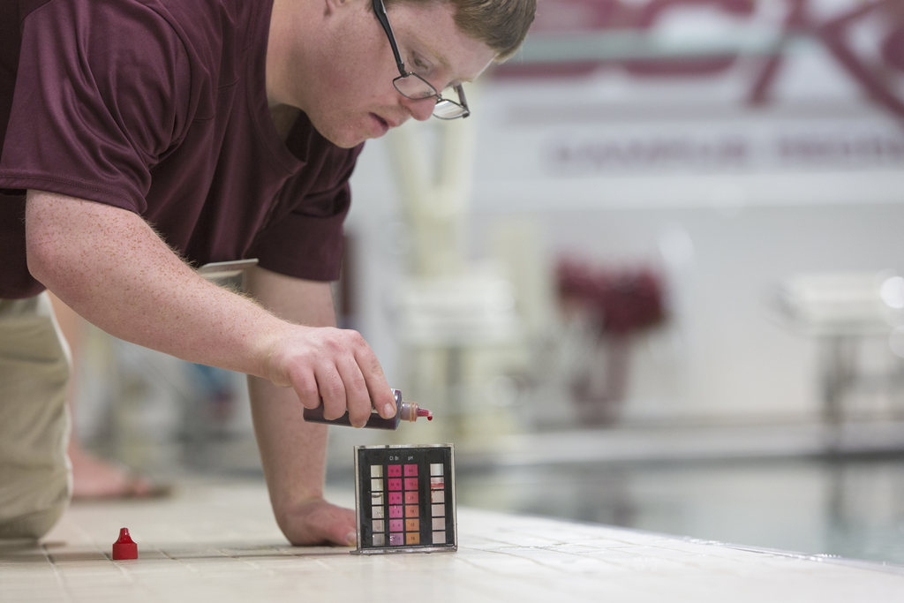
Worksheet Question 2
Identify the major learning goals for your teaching activity.
Questions to ask:
  What do you want VR counselors to know or do after this teaching activity?
  Does it involve addressing knowledge, attitude, skills, or practice or some combination of those?
Notes:
Once you have a general topic, it is useful to write down specific learning goals. What do you want participants to learn? What do you want them to know, or be able to do, that they did not know or could not do when they arrived? Setting learning goals at the start helps you stay focused as you plan. When you teach, sharing the goals also helps learners know what to expect and understand why each part of what you are sharing is important.
For example, for this training, our goals are as follows:
Identify the principles of adult learning.
Propose ways to incorporate adult learning principles into teaching VR counselors about research-based practices for clients with autism spectrum disorder or students with disabilities.
You can see we are doing that: We presented the learning principles at the start and now are trying them out.
Your learning goals depend on what you need to teach and what your audience needs. It could be very simple: being able to show that our learners understand how to use adult learning principles as they teach their VR counselors. If knowledge is the goal, it could be a set of goals to learn different types of information. Alternatively, you might want to have people identify why a new skill is important, learn the steps of learning that skill, and then practice that skill.
9
Think about the different ways of approaching of adult learning: knowledge, attitude, skills, and practice. Does your audience need all of these (or just one or two) to reach your learning goals? Does what you want to teach have a single goal or several goals that are interrelated?
Finally, think about what you want to have happen when the VR counselors leave the room. What should they be able to tell someone else what they learned?
It is important to note that when we say “attitude,” we need to respect where learners are coming from. You might need to introduce a new policy or practice, and your audience might be skeptical. They might have good reason to think that a new policy will make their work harder or more time-consuming, for example. You might want to improve their attitude about the policy, but telling adult learners that you will change their attitude is rarely a good idea. You can imagine it might not go well. Instead, if attitude is the goal, you might want to focus on identifying what is in it for them: How will this new policy, skill, or procedure align with what they think is important, solve a problem they have, or help their clients? You also might want to identify barriers in advance or make part of the training a session of identifying the barriers as a group and coming up with ways to make the new policy fit better with their work environments. This goes back to a key point about adult learning: respecting adult learners as goal and relevancy oriented.
For my example, I will assume that on-the-job social skills coaching is something that VR counselors are not currently doing. I know they work with clients on other job skills, such as showing up on time and asking questions. I know they are busy and do not have a lot of time with each client. I also know they are focused on making sure that employers feel as if the clients are fitting in at the work site and feel confident in the work environment. Therefore, my overall goals might be as follows:
Describe how on-the-job social skills training can help people with autism spectrum disorder have a better workplace experience.
Outline the major elements of social skills training.
Practice social skills training.
Thinking this through helps me figure out how best to present the topic in a way that aligns with how they see their job (attitude), what information they need (knowledge), and what they need to practice to adopt this new approach (skills).
Take a minute or two and think about your goals for teaching. You can adjust them later but think about how to break down your topic into discrete goals.

Slide 10

Worksheet Question 3
Identify specific skills or knowledge that you want to teach. These may be unique or might fit together as part of a package. For example, you might give evidence that family counseling is effective, present a case study of family counseling, and teach skills on how to conduct family counseling.
Notes:
The next part of this exercise gets more specific and is more like an outline to help you determine what you need to teach, based on your goals. If your goal was for VR counselors to become familiar with a new state policy, the specific knowledge might be walking through each part of the policy, identifying what has changed, and identifying the implications for daily work. If your goal was to use a new intake form, the knowledge, skills, and practice would be going through each part of the form, identifying any difficult or unclear portions and how to fill them out correctly, and trying out the new form with a sample case.

Slide 11

Worksheet Question 3
What is the best starting point for the VR counselors on your team?
Do they need to know about new evidence or programs?
Do they need to identify ways to overcome hesitation about taking on new skills or activities?
Do they need to learn specific skills?
Do they need to practice those skills?
Notes:
It can be tempting when planning how to teach a skill to start at the beginning and go through every step in detail, to be as complete as possible. However, that may or may not be what your learners need. Before doing this step, revisit the principles of adult learning:
What do your learners need to know?
Is this a case where attitudes and barriers are important?
What skills do they already have? What skills would be new or need adjustment?

Slide 12
Worksheet Question 3
What knowledge, skills, and attitudes do the VR counselors on your team already possess?
Are they new in their roles or experienced?
What do they believe is important and valuable about their roles?
What do they believe are the biggest challenges in their work?
What are their goals and how can this teaching activity help them meet those goals?
How does your teaching topic apply to their on-the-job needs?
How can they use the information tomorrow?
Notes:
Are your learners new on the job or veterans?
If your learners already have a lot of expertise, you might focus on only what is different instead of everything from soup to nuts. You want to meet them where they are and respect their expertise. Conversely, if you have a new team or one with mixed experiences, you might want to structure your teaching with more basic or refresher information and give counselors who are more experienced an opportunity to help newer colleagues.
Also, think about how to make the training practical. Is this good-to-know information or does it change something right away? Think about how your training topic might affect their next appointment or their job next week. Making information relevant shows respect for adult learners’ time.
In my example, I might want to start by sharing the case study I found: It will give them
the basics of what social skills training is and an example of how it was successful in a similar organization. After that, I might want to tie it back to our clients and their goals so that VR counselors can start to picture how this will address challenges and opportunities seen in their work. I might walk through the actual steps of what social skills training should encompass. Finally, I might want to plan an opportunity to practice the coaching together.

Slide 13
Worksheet Question 4
Match up what you need to teach with methods that respect adult professionals
Focus on what learners already know and what problems they are trying to solve
Have adult learners identify opportunities for their clients and barriers to adopting a new practice
Have them identify ways to overcome these barriers
Notes:
Now that you have in mind the specific things you want to teach, this is a good time to think about how to teach them. Again, this goes back to who your adult learners are: They are self-directed, have their own experiences and skills, and know what they want to do. Therefore, the next step is matching up what you need to teach with methods that respect them as the professionals they are.
Sometimes a combination of a lecture and slides is the most efficient way to deliver information and makes the most sense. If you want to present basic details about a new state policy, that might be the best approach—at least to start. However, remember that you want to teach around what learners already know and what problems they are trying to solve in their own jobs. We tried to apply this principle in this presentation today: Although we spent a few minutes outlining the principles of adult learning, most of our time has been spent giving you an opportunity to think through how you can use these principles to solve challenges in your own work settings.
Beyond basic instruction, you can have adult learners identify opportunities for their clients and barriers to adopting a new practice, along with ways to overcome these barriers.

Slide 14
Worksheet Question 4
Topics for Teaching | Ideas for Creating Useful and Relevant Teaching
A new service implemented by another organization | Ask learners how that service would help their clients, what aspects would work well, what challenges would occur and how they could adapt the service to fit their work environments.
Using a new form | Work through a new form together, demonstrate it’s proper use.
A coaching technique | Model and discuss a coaching technique, allow opportunity to practice the skill
On the job social skills coaching | Present case study, be explicit about the skills, allow opportunity to practice the skill
Notes:
1. For example, if you start by presenting a case study of another organization and how it implemented a new service, you might want to then engage your learners by asking how that service would help your clients, what aspects would work well, what challenges might occur, and how they could see adapting the service to fit their work environments. Teaching skills and giving learners a chance to practice them also are key parts of adult learning.
2. You might want to take a sample case and work through a new form together, demonstrating proper use.
3. Alternatively, you might want to model and discuss a coaching technique and give learners an opportunity to practice with each other.
4. In my example, I might introduce the case study by sending it to the VR counselors to read in advance. If we were having a formal meeting, I might spend a few minutes presenting it myself. Next, I would highlight the parts that most relate to our organization and clients, which will help them relate it to their jobs and opportunities to serve our clients’ needs better. Next, I would want to get concrete about what the actual skill is: When and how should it be done? What does that look like? Finally, I would build in a chance for the counselors to practice it with each other or me.
Take a few minutes to go back to each learning point and think about the most effective way to help your learners take them in.

Slide 15

Worksheet Question 5
Think about what materials
you will need or what tools VR counselors will need to learn, practice, or put this teaching
into effect.
Resources
Notes:
Now that you know what you want to teach and how, the last part is identifying the resources you need. Would it help to show a video of a case study? Develop slides about a new policy? Develop a script and notes for practicing a new coaching technique? Prepare examples of a new form? Tie the resources back to each part of the activity, where appropriate. Write some early notes about where you can get the materials you need and how much you will need.
For my example, I might need an article or a summary of the original case study, or I might want to put together a short presentation about the study and the ways it applies locally. Then I would want a worksheet or guide—or even a cheat sheet—to help VR counselors learn and keep track of the main parts of social skills training. Finally, I would want to come up with a scenario where they could practice it—either taking turns with each other or working with me.

Slide 16

Conclusion
Build on what learners already know.
Identify the knowledge, attitude, skills, or practice that will be most relevant to their needs.
Deliver teaching in the way that matches learners’ needs.
Notes:
This wraps up the exercise portion of today’s training. I hope that you all have some ideas about how to start planning training for the VR counselors in your organization. These skills will come in handy throughout the curriculum as you are exposed to new evidence for VR counseling and different populations. As you learn yourself, think about how you can present information in ways that make it meaningful for your team.

